Slide 1

Predicting the Overall Rating of FIFA players with Linear Regression
Jesús Cabezas
Sandra Cunha
Notes:
WE ARE GOING TO BUILD A MODEL TO PREDICT THE OVERALL RATING OF PLAYERS WITH LINEAR REGRESSION

Slide 2
Content
Column Selection
Data Cleaning
Exploratory Data Analysis
Correlation Heatmap
Features Selection
Numerical Features Transformation
Categorical Features Transformation
Modeling
Model Evaluation
Conclusion

Slide 3
Column Selection
Age OVA Nationality Club BOV Position POT Value Crossing Finishing Heading | Short Passing Volley Dribbling Curve FK Accuracy Long Passing Ball Control Acceleration Sprint Speed Agility Reactions | Balance Stamina Strength Long Shots Aggression Interceptions Positioning Vision Shot Power Jumping | Penalties Marking Standing Tackle Sliding Tackle GK Diving GK Handling GK Kicking GK Positioning GK Reflexes
Notes:
WE SELECT THE COLUMNS BASED ON THE CRITERIA WHICH ARE MORE IMPORTANT FOR THE PERFORMANCE OF PLAYERS.
ORIGINAL DATA (17125, 107)
WITH SELECTED COLUMNS: (16991, 41)

Slide 4
Data Cleaning
Standardize header names
Checking for nulls
Grouping values in “Position” Column to 'DF', 'MF', 'AT', 'GK'
Notes:
WE DELETED THE COLUMNS WITH NULLS, BECAUSE THEY WERE REPEATED ROWS.

Slide 5

Exploratory Data Analysis

Slide 6
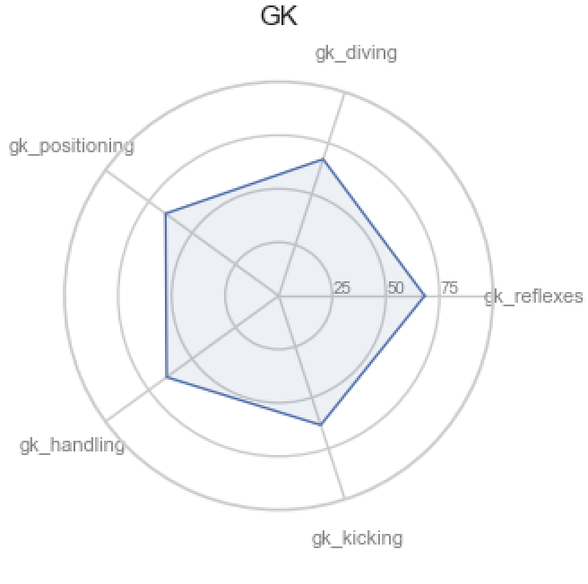
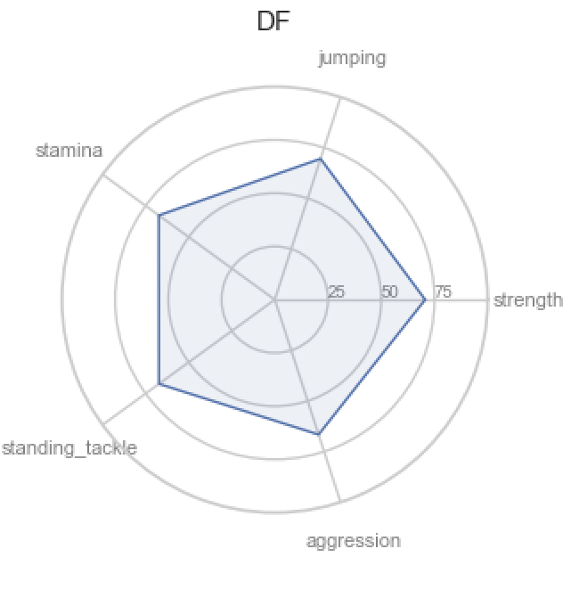
Top 5 Features by Position

Slide 7
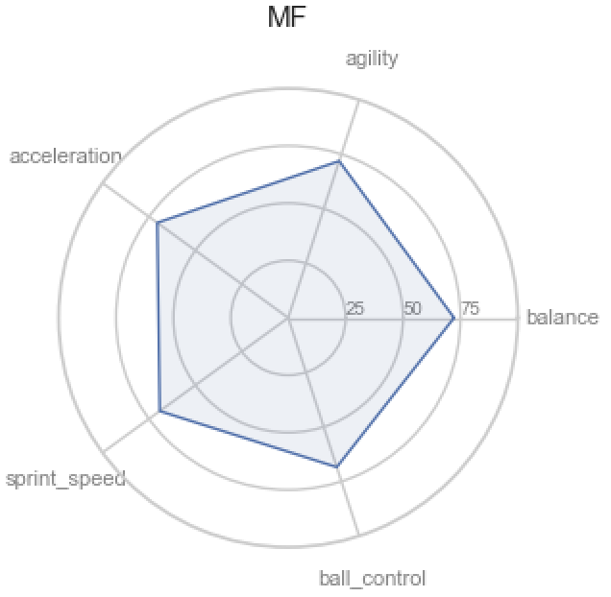
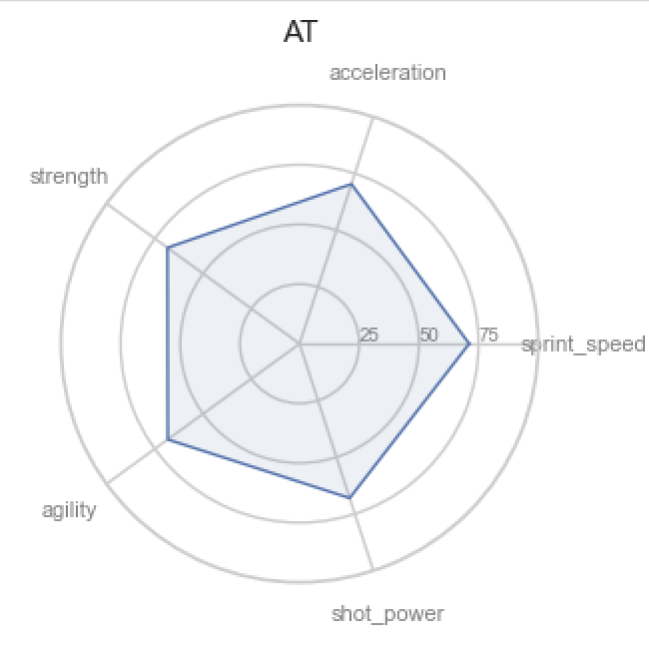
Top 5 Features by Position

Slide 8
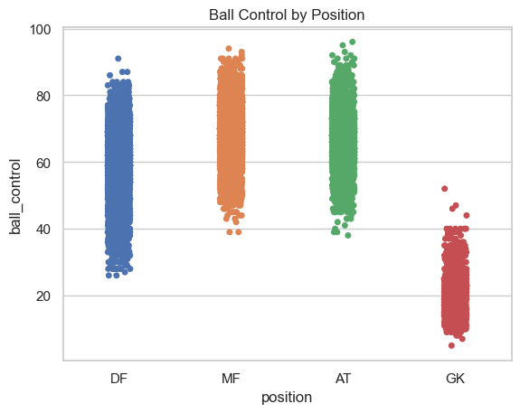
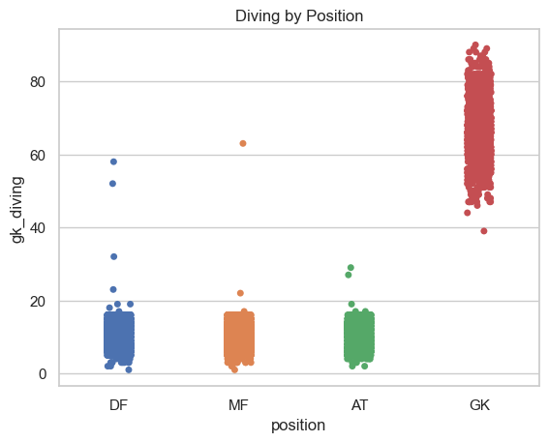
Some differences in features

Slide 9
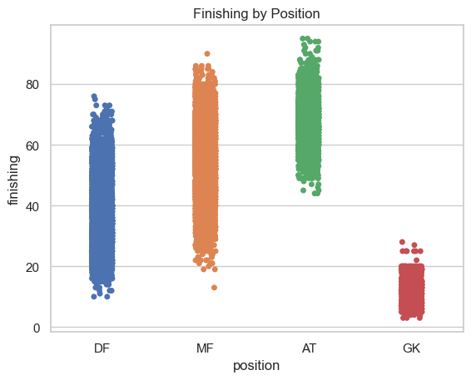
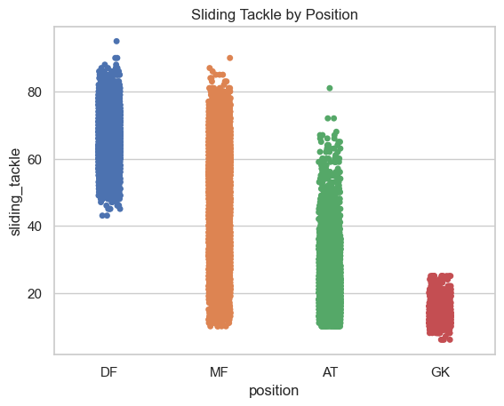
Some differences in features

Slide 10
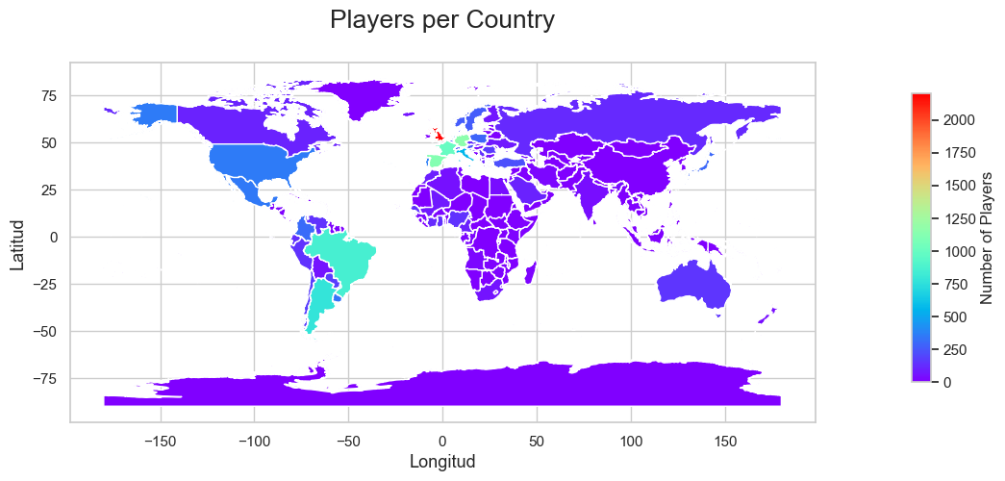

Slide 11
Correlation Heatmap
Understand which variables are related to each other;
The relationship with our target: “ova” - Overall Rating;
Feature selection: which columns are relevant for our model?
Notes:
WE HAVE BUILT A CORRELATION MATRIX AND A HEATMAP TO:

Slide 12
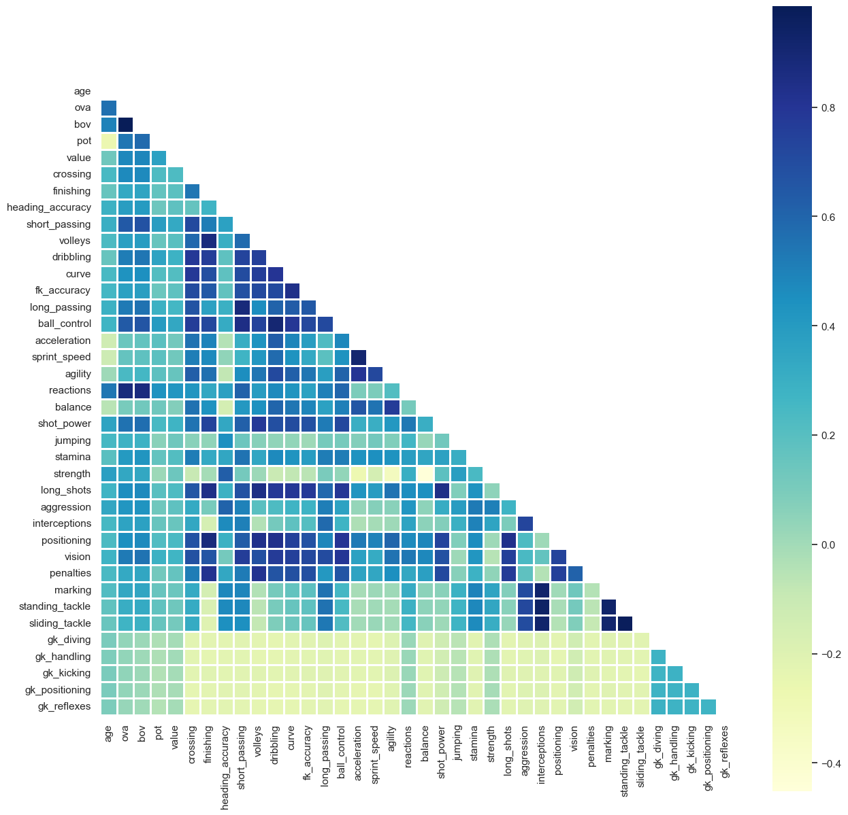
Correlation Heatmap

Slide 13
Feature Selection
Moderate to High Correlated columns (above 0.8) with our target “ova”:
vision
shot_power
reactions
ball_control
short_passing
bov

Slide 14
Preprocessing
Numerical Features Data scaling Box-cox | Categorical Features Dummy Encoding Nationality Position
Notes:
Data scaling: Scaling our data to the range of 0 and 1 using MinMaxScaler().Box-cox: To make the data look more normal distributed / normal shape
WE DROP NAME COLUMN AND KEPT NATIONALITY AND POSITION COLUMN. WE TRIED TO CONVERT NATIONALITY OF PLAYERS TO CONTINENTS SO WE WOULD HAVE LESS VALUES BUT NO TIME.
THEN WE CONCATENATE OUR TRANSFORMED NUMERICAL AND OUR CATEGORICAL

Slide 15
Modeling
X-y split
y = finaldata["ova"] – Our Target “Overall”
X = finaldata.drop(["ova"], axis=1)
Train-test split
30% --> test , 70% --> train

Slide 16
Model Evaluation
Results with Box-cox: R2 = 0.98 RMSE = 0.71 MSE = 0.50 MAE = 0.53 | Results without Box-cox: R2 = 0.98 RMSE = 0.92 MSE = 0.85 MAE = 0.69
98% of the variance of the target is explained by the variance of the features
±0.7/±0.9 difference between values predicted by the model and the actual values

Slide 17
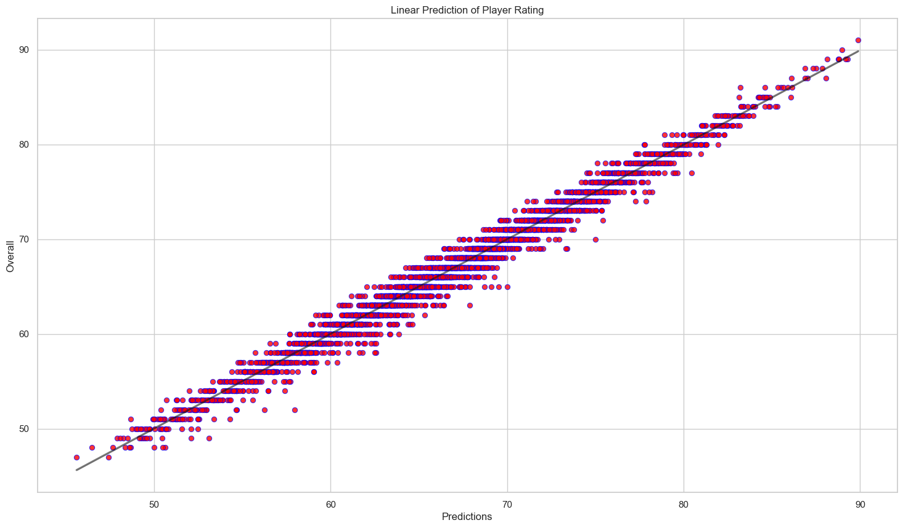
Notes:
rmse: LITTLE deviation of the actual y-values from the regression line.

Slide 18

Conclusions
Model performs better without categoricals;
Slightly better prediction using box-cox transformation;
Thank you!!
Notes:
R2 = 0.9829952027590091
RMSE = 0.7108417342985153 (rmse: LITTLE deviation of the actual y-values from the regression line.

